Slide 1
Today’s Objectives
Describe our overall objectives
Discuss the syllabus
Present some basics of SW Construction
Design
Coding
Verification (and Validation)
Unit Testing
Integration Testing
Debugging

Slide 2
Syllabus

Slide 3
What is Software Construction?
"The detailed creation of working software through a combination of –
coding
verification
unit testing
integration testing
debugging."
IEEE SWEBOK (Guide to the Software Engineering Body of Knowledge), V3.0, 2005
But, this definition leaves something out…

Slide 4
"Software Construction … is most strongly linked to Software Design and Software Testing…"
"… because the software construction process involves significant software design and testing."
So we will consider SW Construction as:
Design
Coding
Verification (and Validation)
Unit Testing
Integration Testing
Debugging

Slide 5
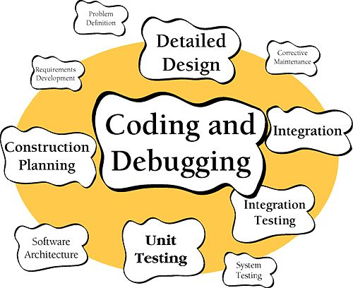
Software Construction

Slide 6
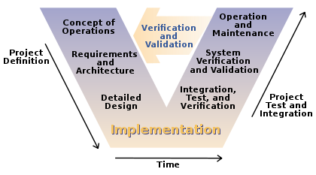
Though we don't teach it (much) in introductory programming courses, good design is make-or-break
Any worthwhile software project is too big to be designed in our heads
There are many different designs that will "work"
not all are efficient, in run time or implementation time
Lots of different design "methodologies"
Various notations

Slide 7
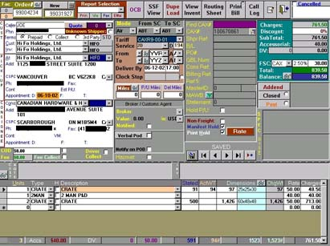
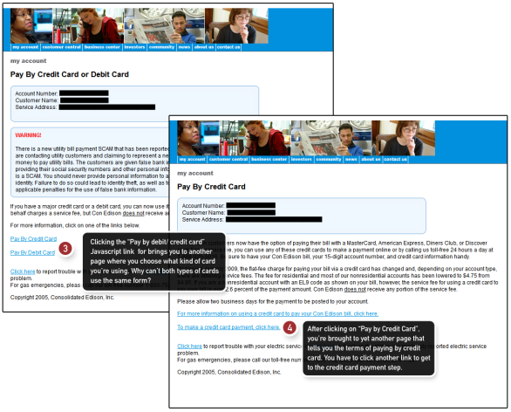
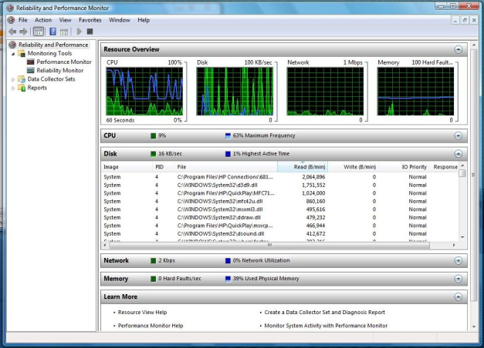
Bad Software Design
UI:
Function:
Performance:

Slide 8
Our detailed coding practice impacts the performance of our programs in all areas
Readability
Reusability
Speed
Correctness

Slide 9
Verification and Validation (commonly labeled V & V) are vital
Verification is ensuring that the product is built correctly
The right outputs for given inputs
The specifications are met
Validation is ensuring that the right product is built
The product fulfills its intended purpose

Slide 10
We are building a new calculator app for use in the oil and gas industry
If our app says "2+2 = 3", it fails verification
The specs say that it should do math correctly
If oil and gas workers say "this thing won't compute shaft depths like the old one did", it fails validation
Maybe the detailed specifications were wrong?

Slide 11
Unit testing involves specific modules and routines; integration testing looks at how they work together
Unit testing is the verification of individual software modules in isolation from everything else
often done by the developers themselves
Integration testing is the verification of the interactions between the modules
usually done incrementally rather than one big phase at the end

Slide 12
Debugging is vital, non-deterministic, hard, a kind of art, and sometimes great fun
Debugging is like a mystery –
Find a dead body
Collect tools
Make a hypothesis
Test it out
Repeat until the problem is fixed
There are tools out there to help
Often multiple problems are interacting

Slide 13
Before Next Class...
Install JDK
http://www.oracle.com/technetwork/java/javase/downloads/index.html
Install IntelliJ - sign up with edu address
https://www.jetbrains.com/shop/eform/students
https://www.jetbrains.com/idea/

Slide 14
Today’s Objectives
Describe our overall objectives
Discuss the syllabus
Present some basics of SW Construction
Design
Coding
Verification (and Validation)
Unit Testing
Integration Testing
Debugging

